Slide 1


Slide 3
The SI standard of mass is a platinum–iridium cylinder kept at the International Bureau of Weights and Measures near Paris and assigned, by international agreement, a mass of 1 kilogram.
It is the carbon-12 atom, which, by international agreement, has been assigned a mass of 12 atomic mass units (u).

Slide 5
To the nearest order of magnitude, the ball contains about 1000 km of string!

Slide 7
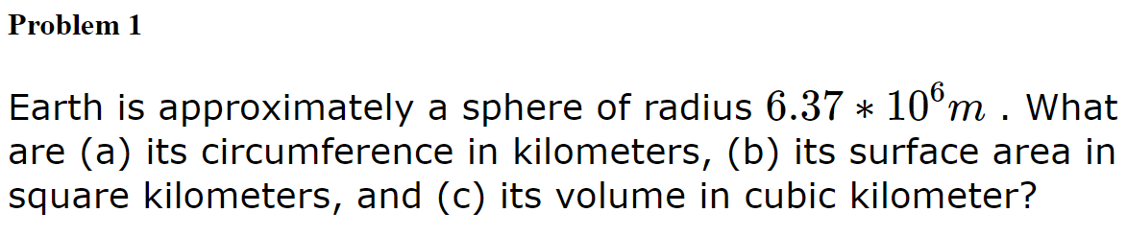
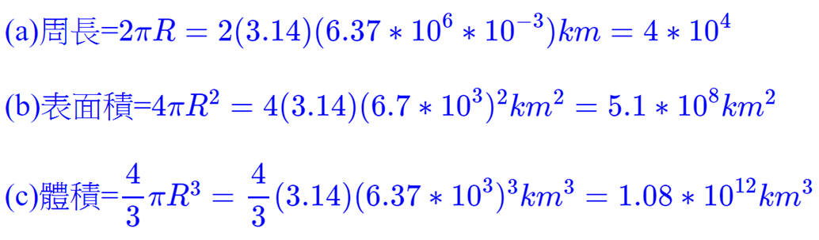




Slide 8
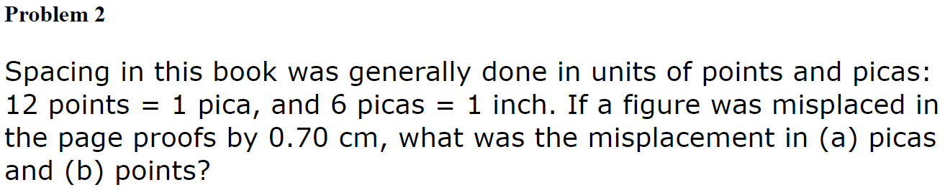
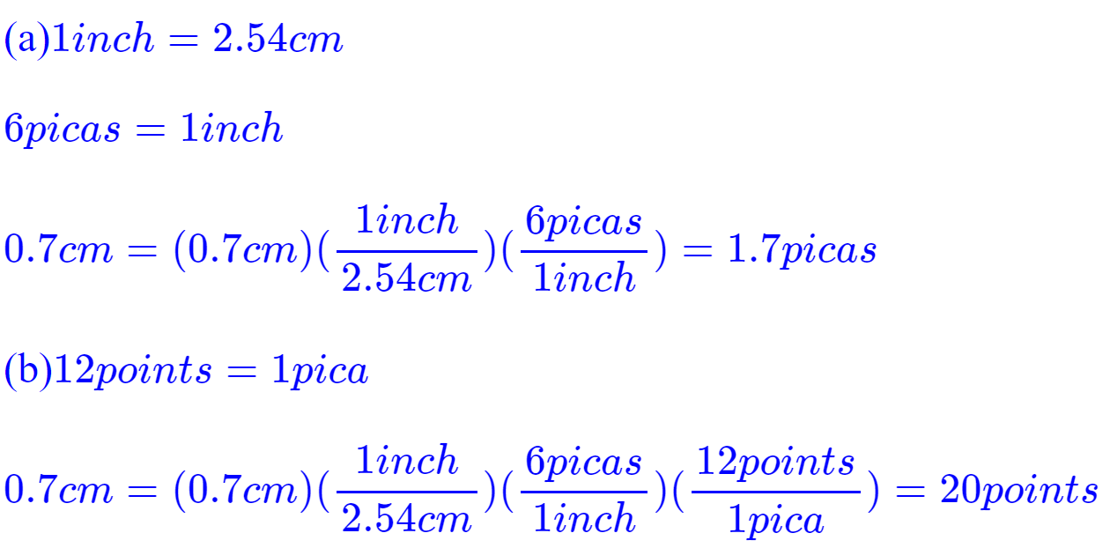
1 pica=1/6英寸

Slide 9
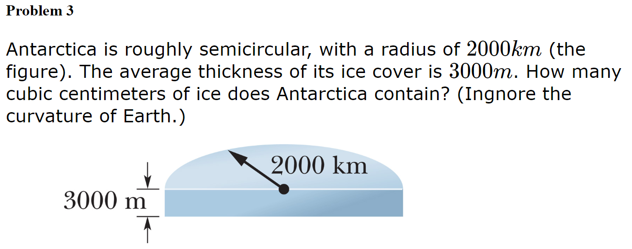
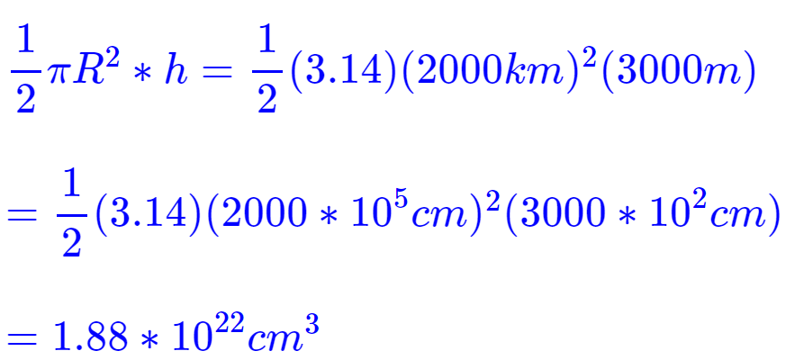


Slide 10
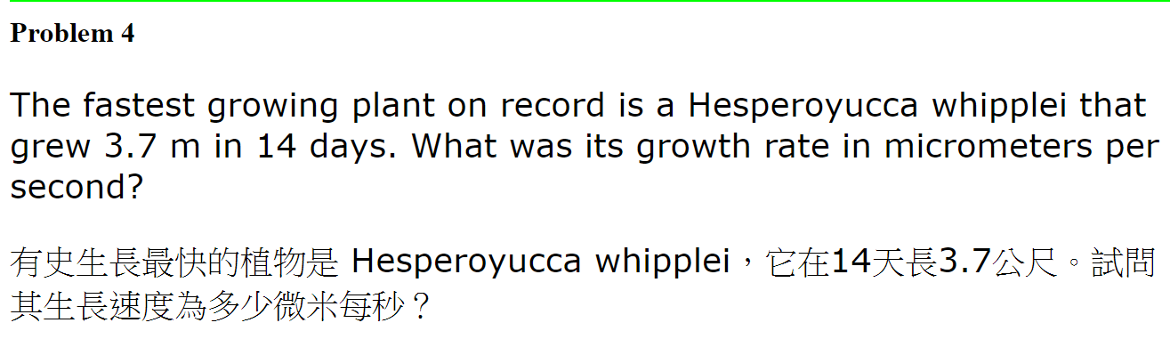
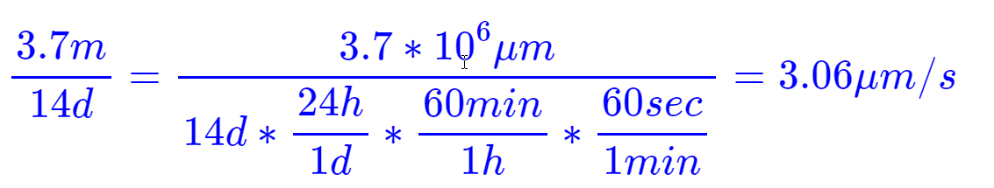
豬鞭草

Slide 11
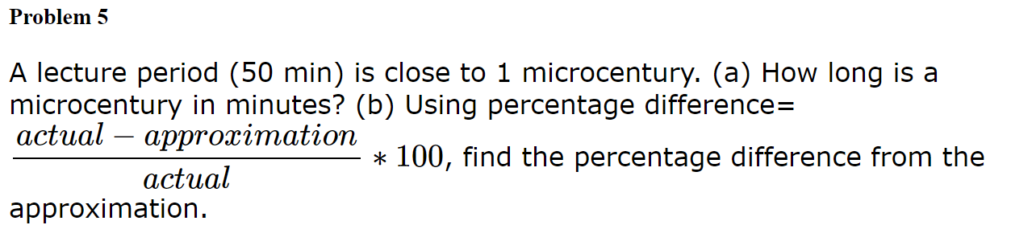
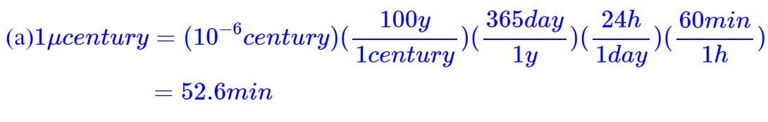
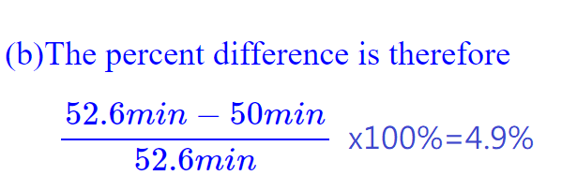

Slide 12
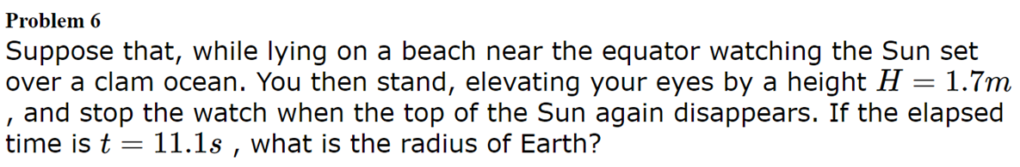

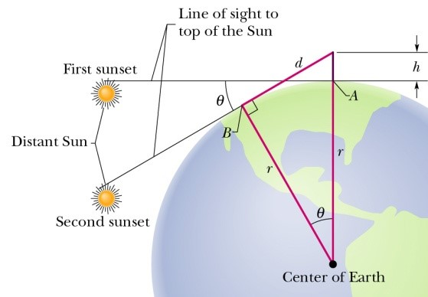







地球自轉一周(360º)24小時

Slide 13
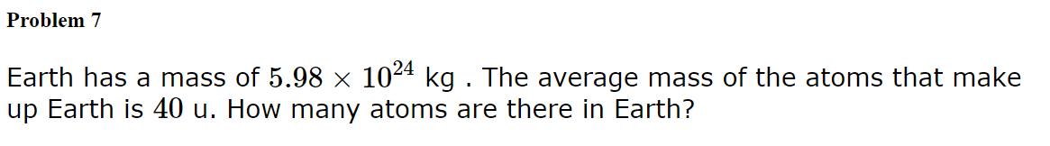
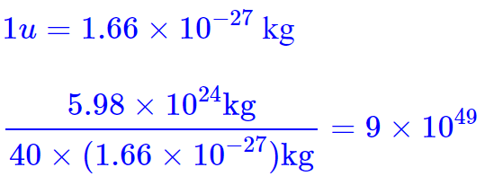


Slide 14
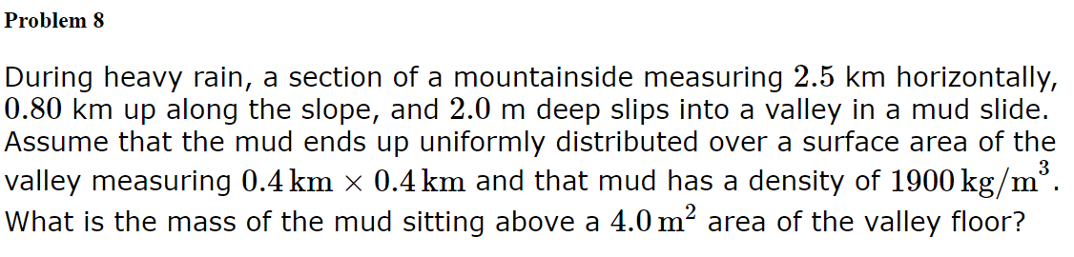
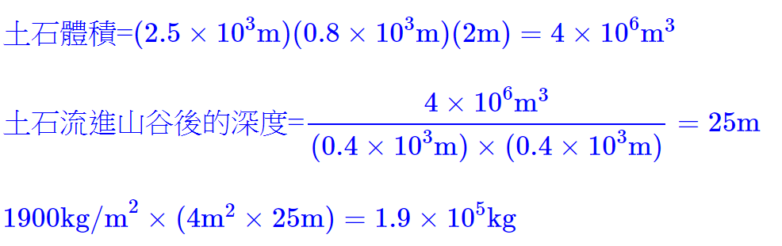



Slide 15
GlowScript 3.0 VPython
scene = display(width=800, height=800, center=vector(1, 1, 1),
background=vector(0.2,0.2,0.4))
box(pos=vector(0,-0.8,0),axis=vector(1,0,1),width=5, length=6,
height=0.7, up=vector(0,1,0),color=vec(1,1,1))
box(pos=vector(0,0,0),axis=vector(1,0,1),width=0.8, length=2.5,
height=0.2, up=vector(-0.5,0.5,0.5),color=vec(0.2,0.5,0.5))
box(pos=vector(0.2,-0.2,-0.2),axis=vector(1,0,1),width=2, length=5,
height=0.4, up=vector(-0.5,0.5,0.5),color=vec(0.2,0.6,0.2))

Slide 16
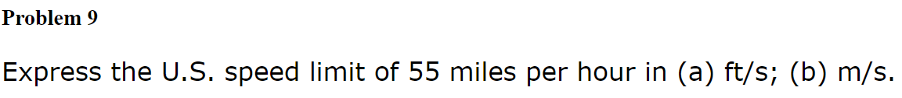
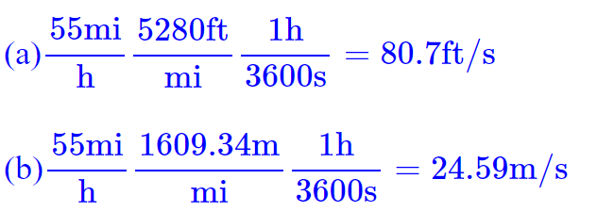
1 英里 = 1,760 碼 = 5,280 英尺 = 63,360 英寸 = 1.609344 公里
1英呎 = 12英吋 = 30.48公分 = 3.048公寸 = 0.3048公尺
(c) 55 mi/hr = 55 x 1.61 = 88.56 km/hr

Slide 18
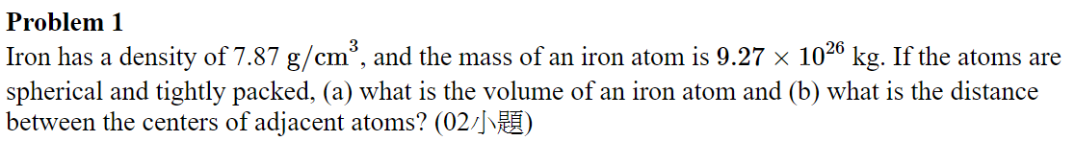

Slide 19
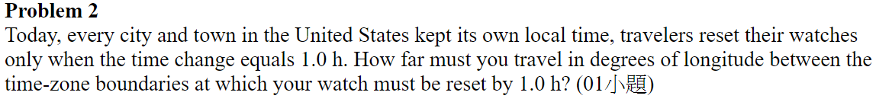
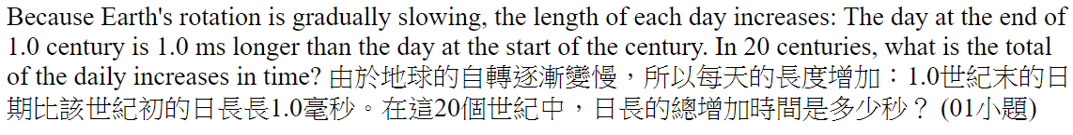

Slide 20
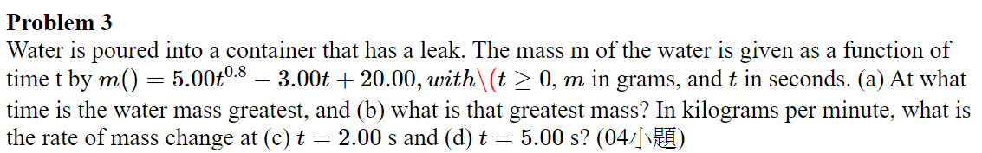

Slide 21
