Slide 1


GP1-L12

Slide 2








Slide 3

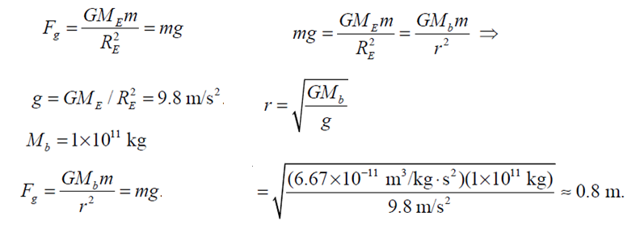

Slide 4

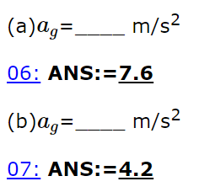


R
4M
M
2R

Slide 5

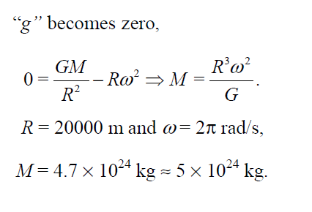
Neutron Stars
A neutron star is about 20 km in diameter and has the mass of about 1.4 times that of our Sun. This means that a neutron star is so dense that on Earth, one teaspoonful would weigh a billion tons! Because of its small size and high density, a neutron star possesses a surface gravitational field about 2 x 10¹¹ times that of Earth. Neutron stars can also have magnetic fields a million times stronger than the strongest magnetic fields produced on Earth.
https://imagine.gsfc.nasa.gov/science/objects/pulsars1.html.old

Slide 6
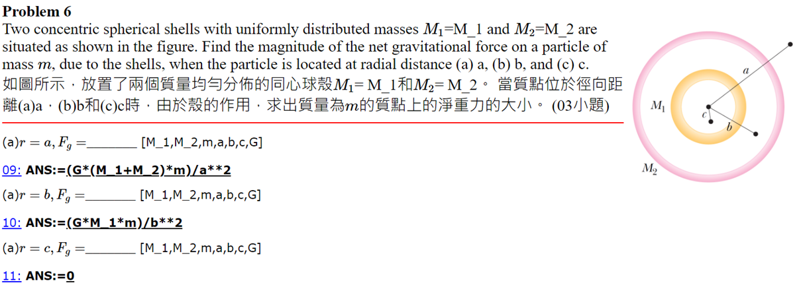
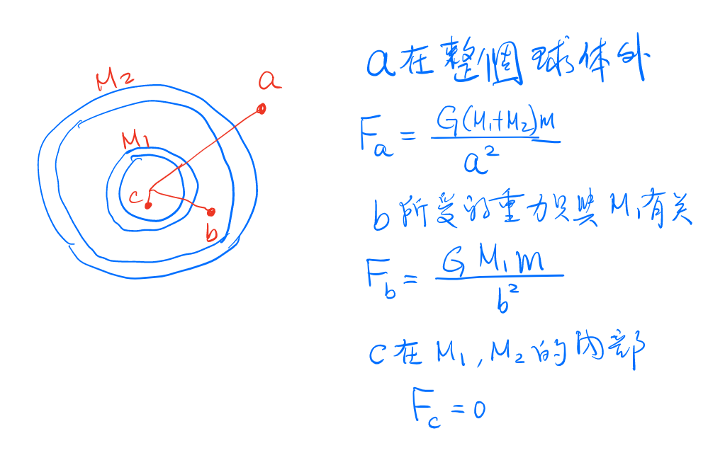
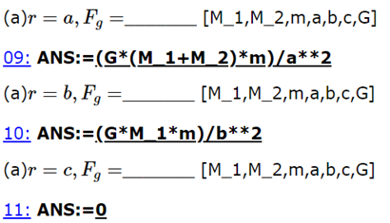

Slide 7

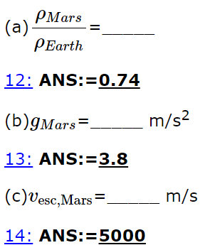






Slide 8

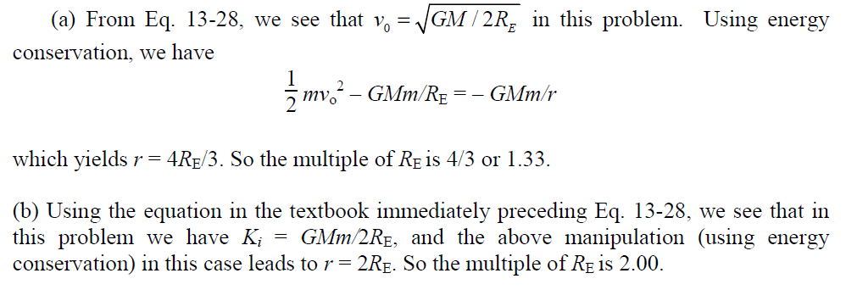
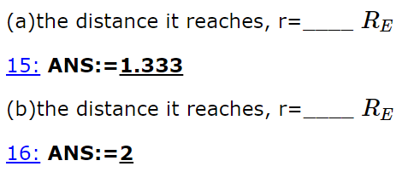

Slide 9



Slide 10

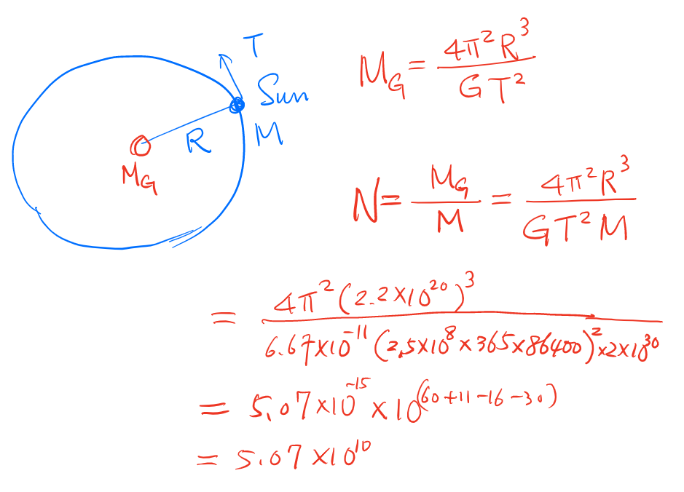
銀河星系恆星數量
1000–4000億
2.5×10¹¹

Slide 13







